Slide 1

Balanced scorecard slide 1
to classify 5 different stages in the forming process
Yong Huang

Slide 2
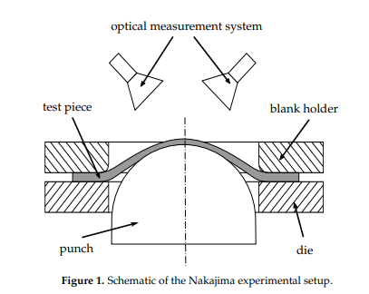
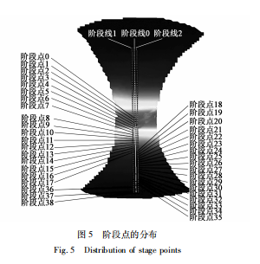


Collecting data
The experiments of the forming process of Aluminum alloy(5083) thin plate
[Trail-1 Trail-2 Trail-3] [Trail-1 Trail-2 Trail-3] [Trail-1 Trail-2 Trail-3] [Trail-1 Trail-2 Trail-3] [Trail-1 Trail-2 Trail-3]

Slide 3
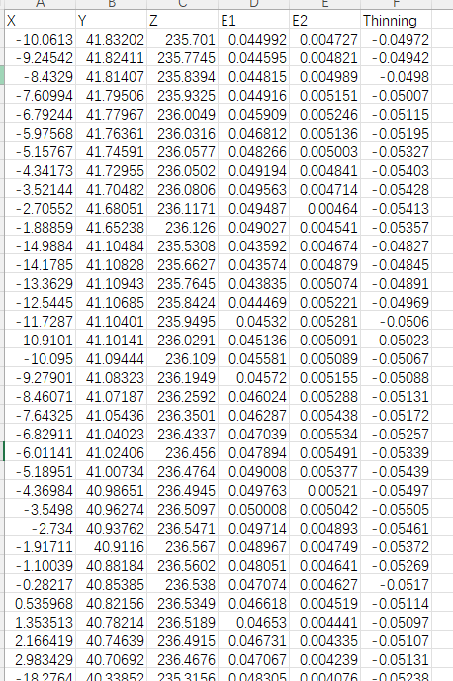
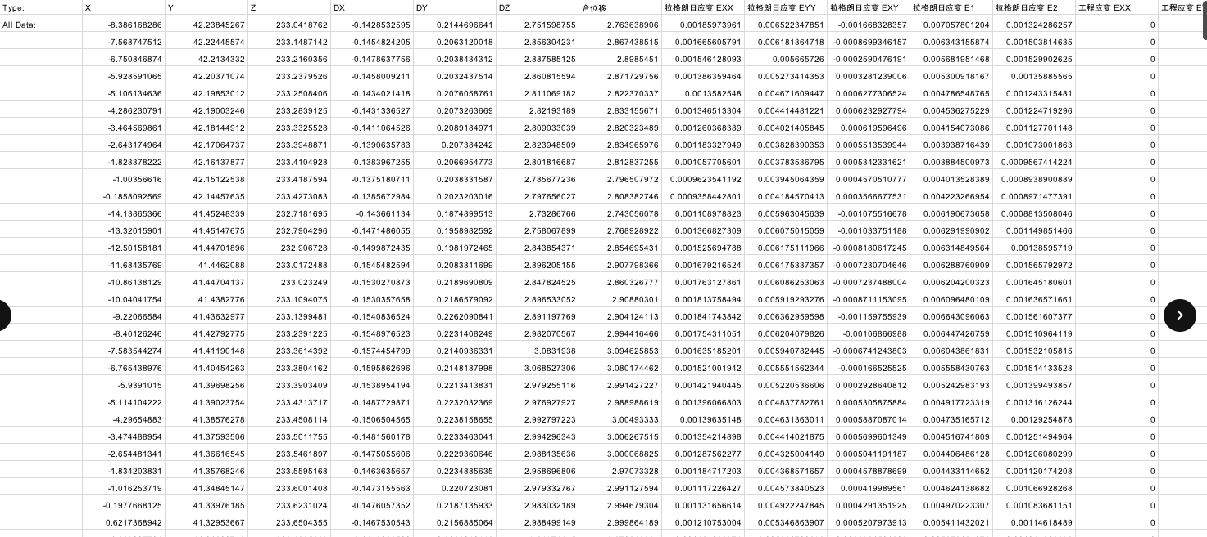
Balanced scorecard slide 4
Cleaning Data
Deleted unnecessary Columns
Simplified columns‘
name
Added additional Column: Thinning

Slide 4
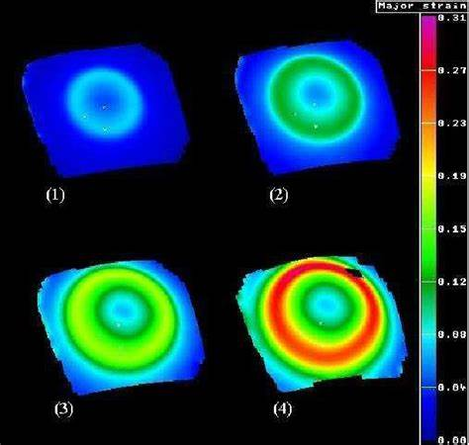
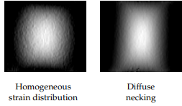
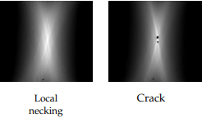
Balanced scorecard slide 4
Labeling Data:
5 different stages in the forming process
Uniform forming1 (0): The strain is evenly distributed.
Diffuse necking(2): The strain is somewhat uneven in a local area, but is not concentrated in a specific area.
Uniform forming2 (1): The strain is evenly distributed.
Crack (4): The strain is concentrated and eventually forms a crack or fracture.
Local necking (3): The strain is concentrated in a small area, and local thinning occurs.

Slide 5
Balanced scorecard slide 5
Labeling Data:
180mm
120mm
100mm
60mm
20mm
[Trail-1 Trail-2 Trail-3] [Trail-1 Trail-2 Trail-3] [Trail-1 Trail-2 Trail-3] [Trail-1 Trail-2 Trail-3] [Trail-1 Trail-2 Trail-3]
Uniform forming1 (0):
Uniform forming2 (1):
Diffuse necking(2):
Local necking (3):
Crack (C4):
To label 5 different stages in the forming process by experts

Slide 6
Balanced scorecard slide 5
Augmented label statistics: Label 0: 3980 Label 1: 3271 Label 2: 4619 Label 3: 1458 Label 4: 636
Augmenting Data:
Annotation statistics:
Annotation 0: 3980
Annotation 1: 2456
Annotation 2: 1991
Annotation 3: 264
Annotation 4: 107
Augmented label statistics: Label 0: 3980
Label 1: 3271
Label 2: 4619
Label 3: 1458
Label 4: 636

Slide 7
Balanced scorecard slide 5
Augmented label statistics: Label 0: 3980 Label 1: 3271 Label 2: 4619 Label 3: 1458 Label 4: 636
Extracting features
# HOG (Histogram of Oriented Gradients)
def compute_hog_features(data, orientations=9, pixels_per_cell=(4, 4), cells_per_block=(2, 2)):
n = len(data)
side = int(np.ceil(np.sqrt(n)))
padded_data = np.zeros((side * side,))
padded_data[:n] = data
image = padded_data.reshape((side, side))
return hog(
image,
orientations=orientations,
pixels_per_cell=pixels_per_cell,
cells_per_block=cells_per_block,
block_norm='L2-Hys',
feature_vector=True,
)

Slide 8
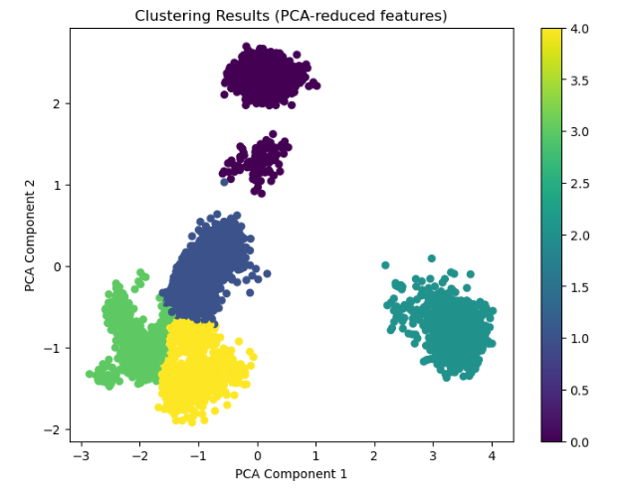
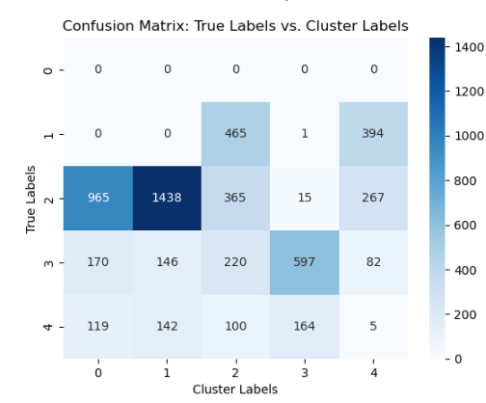
Clustering by KMeans
Adjusted Rand Index (ARI): 0.2213
Normalized Mutual Information (NMI): 0.2738

Slide 9
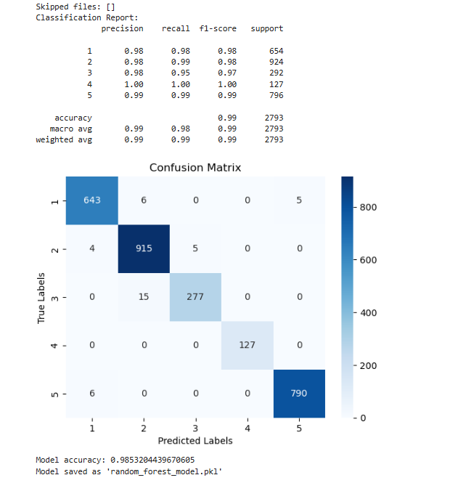
Balanced scorecard slide 5
Classifying by Random Forest
Model accuracy: 0.9853204439670605
Changing Label ‘0 ‘ to Label ‘5’

Slide 10
Balanced scorecard slide 10
THANK YOU

